Slide 1
Level set methods
Stephen Millmore
Laboratory for Scientific Computing

Slide 2
Outline
Implicit boundary methods
Numerical methods for level sets
Defining level set functions
Reinitialisation

Slide 3
Representing a sharp interface
Within this lecture we consider the underlying mathematical and numerical techniques required for sharp interface methods
To achieve this, we need a technique which can identify the location of a material interface, and use this to split the computational domain into two or more regions
This description suggests a distinction between the determining the location of the interface and the application of the multiphysics behaviour between the distinct regions
This distinction does exist - here we cover the theory behind the representation of the interface
However, this theory can extend to other applications, beyond sharp interface multiphysics methods

Slide 4
Outline
Implicit boundary methods
Numerical methods for level sets
Defining level set functions
Reinitialisation

Slide 5

How is a boundary represented?
If we wish to use a sharp interface multiphysics method, then we need a technique which both describes and evolves the location of an interface
This may seem straightforward - we simply map a function to the interfaces which exist between materials
Though will this work with finite volume (or finite difference) approximations?
Perhaps unsurprisingly, there are multiple approaches which can be used to deal with material interfaces

Slide 6
Explicit and implicit boundaries
For numerical methods involving material interfaces, there are two classes of method – explicit or implicit boundary representation
Explicit boundaries:
You always know exactly where your boundary is
In some ways, the edge of the computational domain is an explicit boundary, to which you must apply boundary conditions
Implicit boundaries:
You don't know precisely where your boundary is, but you do know which side of the boundary you are on
In some ways, the discontinuities in Euler equation solutions are implicitly defined (ignoring the smearing)

Slide 7
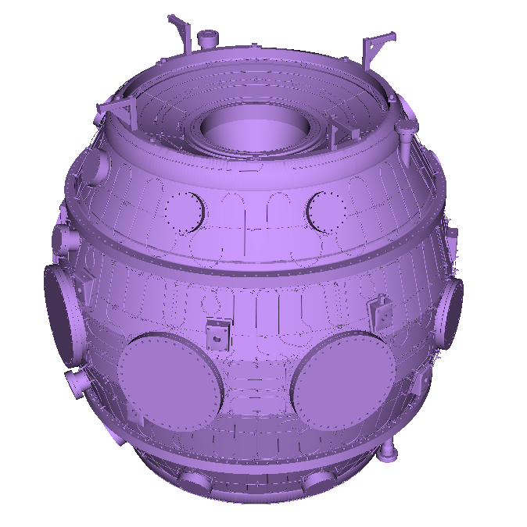
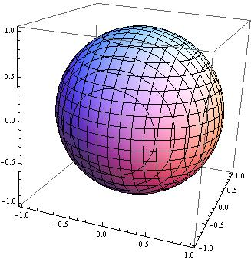
What is an explicit boundary?
An explicit representation of an interface deﬁnes a surface, or curve, which exists only at the location of the interface
For example, a bubble could have a boundary described by
But what if you can't fit a function, or simple linear combination of functions, to your interface?

Slide 8
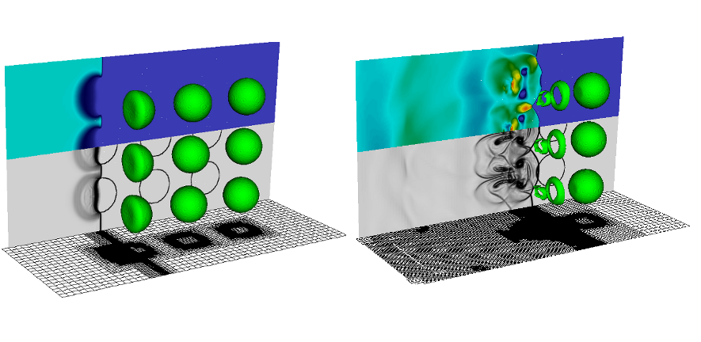
Challenges with explicit boundaries
Even if it is difficult to map a function to a surface, that is not the main issue
For multiphysics simulations, we need to be able to model how an interface moves
This movement will be determined by the actual algorithm implemented for your model
To understand these challenges, consider the interaction of a shock wave with one or more gas bubbles
This interaction causes the bubble to break up; how do we ensure that our method knows when to do this?

Slide 9
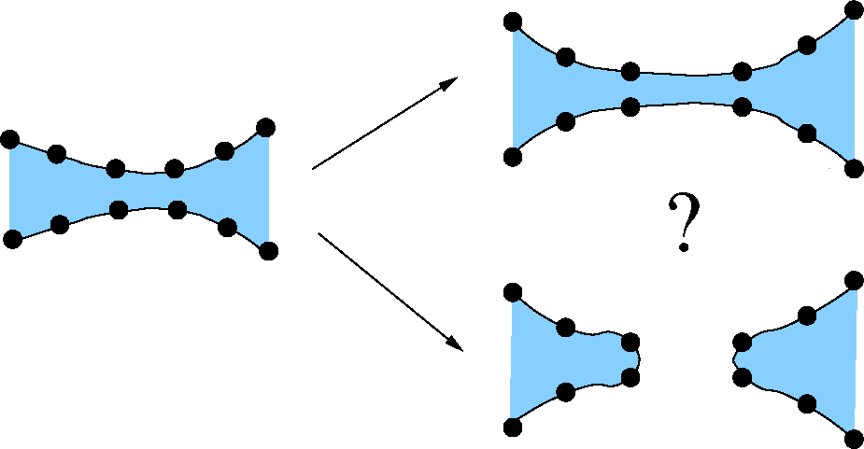
Challenges with explicit boundaries
It is diﬃcult to accurately determine how this boundary representation should be ‘split’ in a physically realistic way
For an explicit boundary method, you would need a technique which could define this

Slide 10
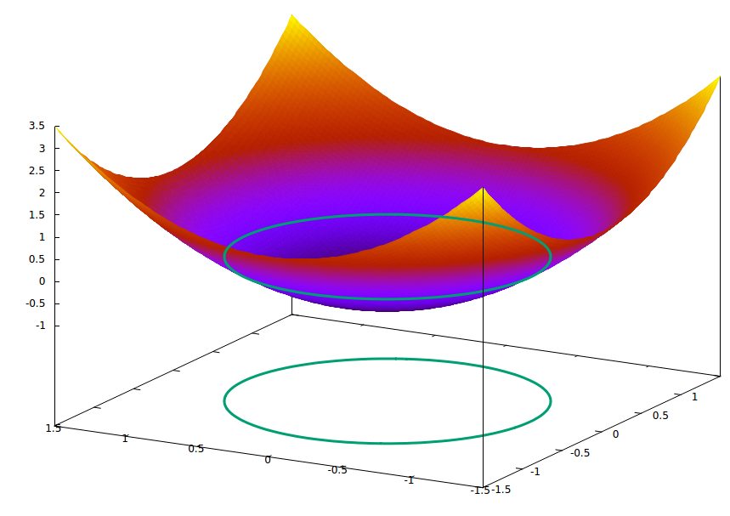
What is an implicit boundary
Instead of treating the boundary as a surface, we can consider it the zero-contour of a scalar field
Our previous example could now be defined through
Clearly this works well with our finite volume methods – we can provide this function at all cell-centred points
We may never know where the interface is exactly, but we will know which side of the interface our cell is on

Slide 11
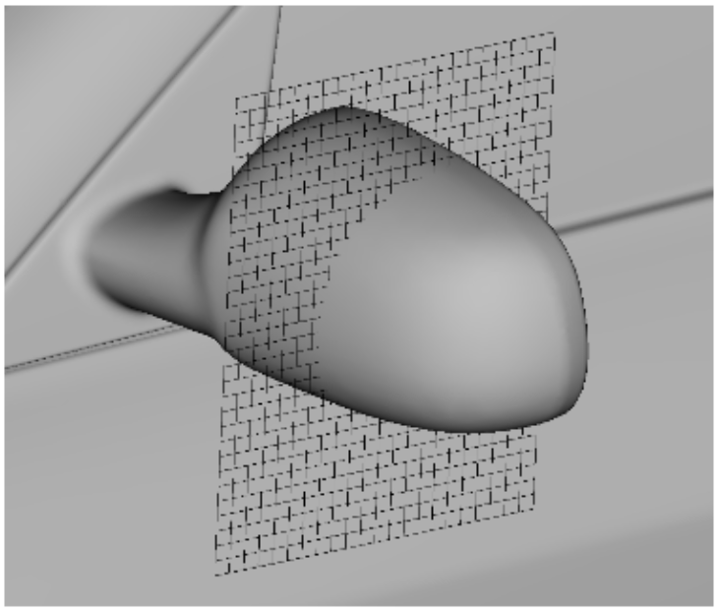
Challenges with implicit boundaries
Clearly the difficulties in determining the boundary of a complex object have not gone away
In some ways, the key challenges have already been seen when cut cell methods were covered – how do you get information about where a boundary crosses a cell?

Slide 12
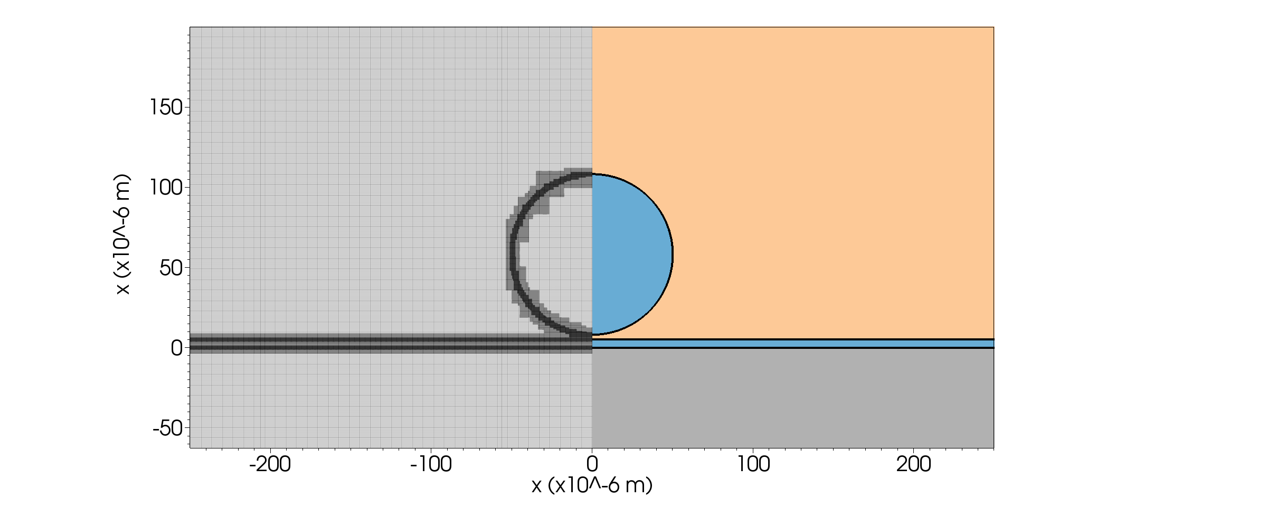
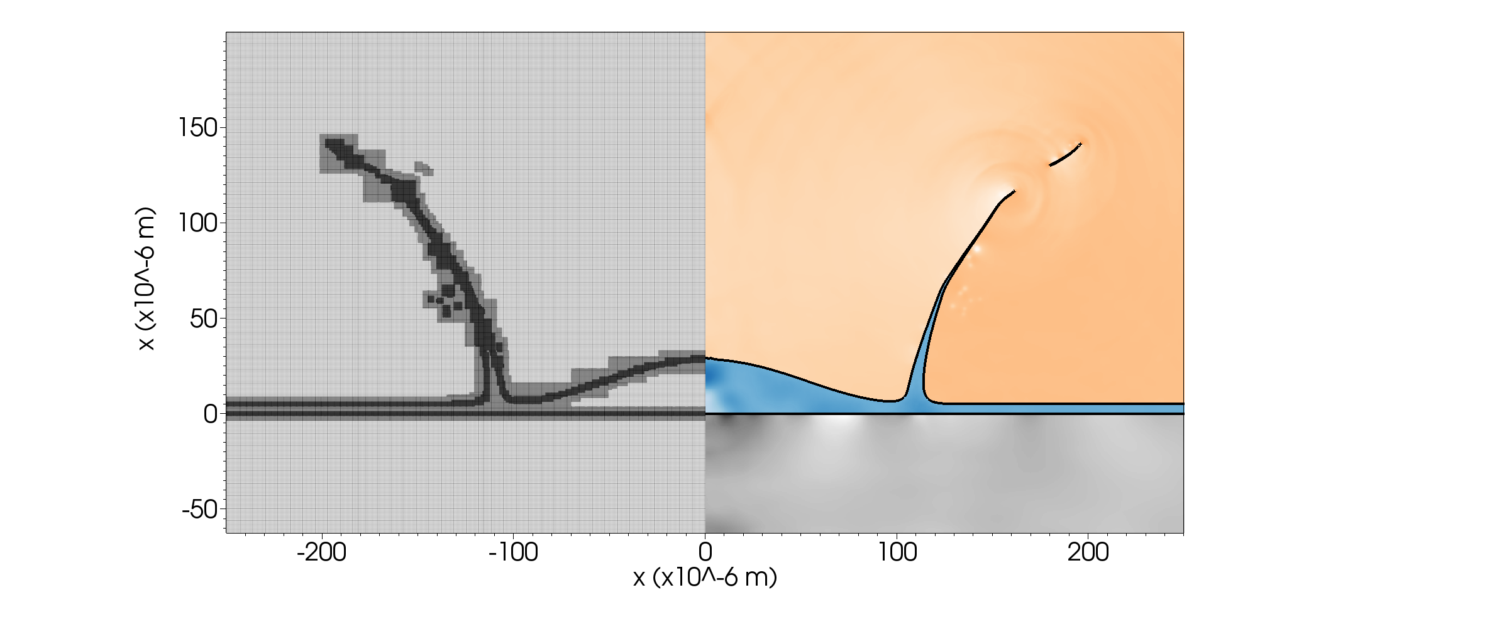
Advantages of an implicit boundary
For many multiphysics methods, knowing what side of the interface you are is almost all you need (knowing how far away you are from it helps)
The key, for our applications, is the fact that merging and splitting happens "trivially"
Effectively, the finite volume evolution of an interface can cause it to merge or to split and we avoid having to worry about sub-cell scale behaviour

Slide 13
Level set methods
We will now assume that we have an implicit representation of an interface at for some initial data for our simulation
Level set methods are a common technique to track this interface as it evolves in time
Although we are going to look at a specific application to multiphysics, level set methods themselves are a more general technique
They can be used to model:

Slide 14

Level set methods
They can be used to model:
Fluid dynamics (free surface flow)

Slide 15

Level set methods
They can be used to model:
Flame fronts

Slide 16
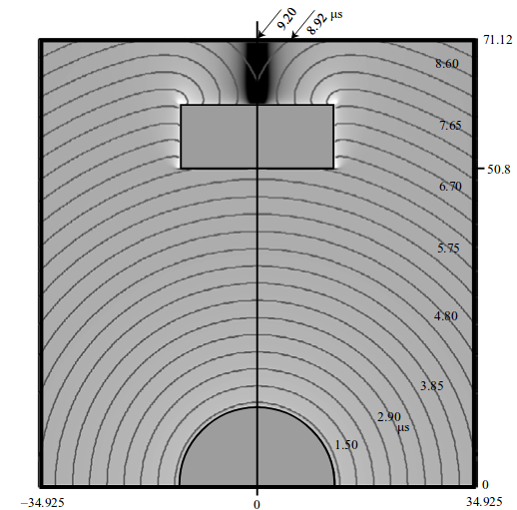
Level set methods
They can be used to model:
Detonation propagation

Slide 17
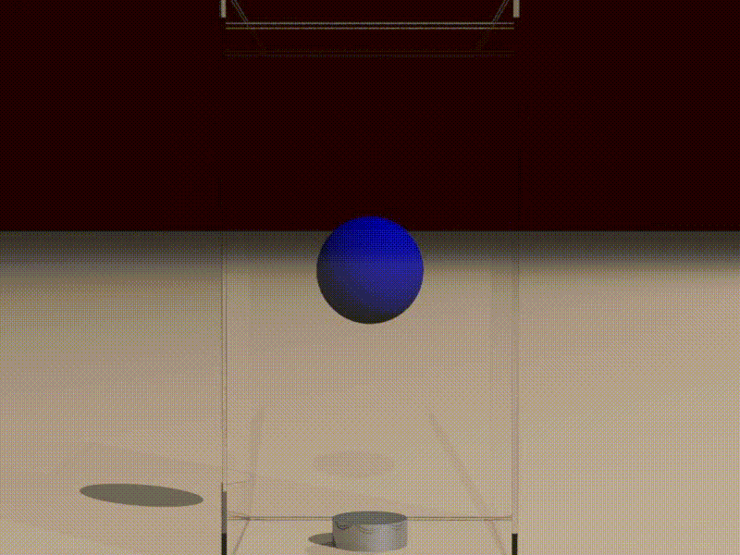
Level set methods
They can be used to model:
Density gradients in incompressible flow

Slide 18
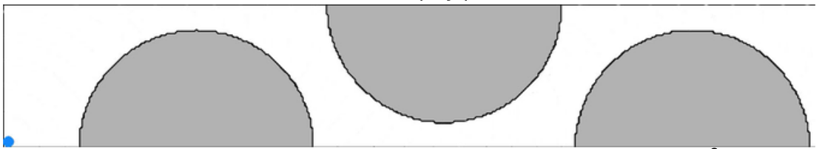
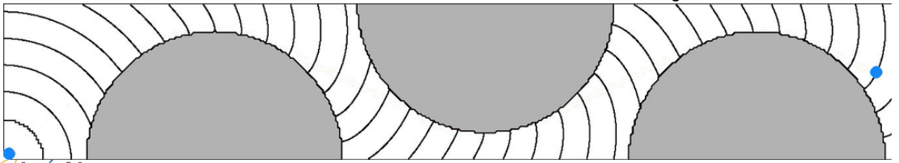
Level set methods
They can be used to model:
Optimal path planning

Slide 19
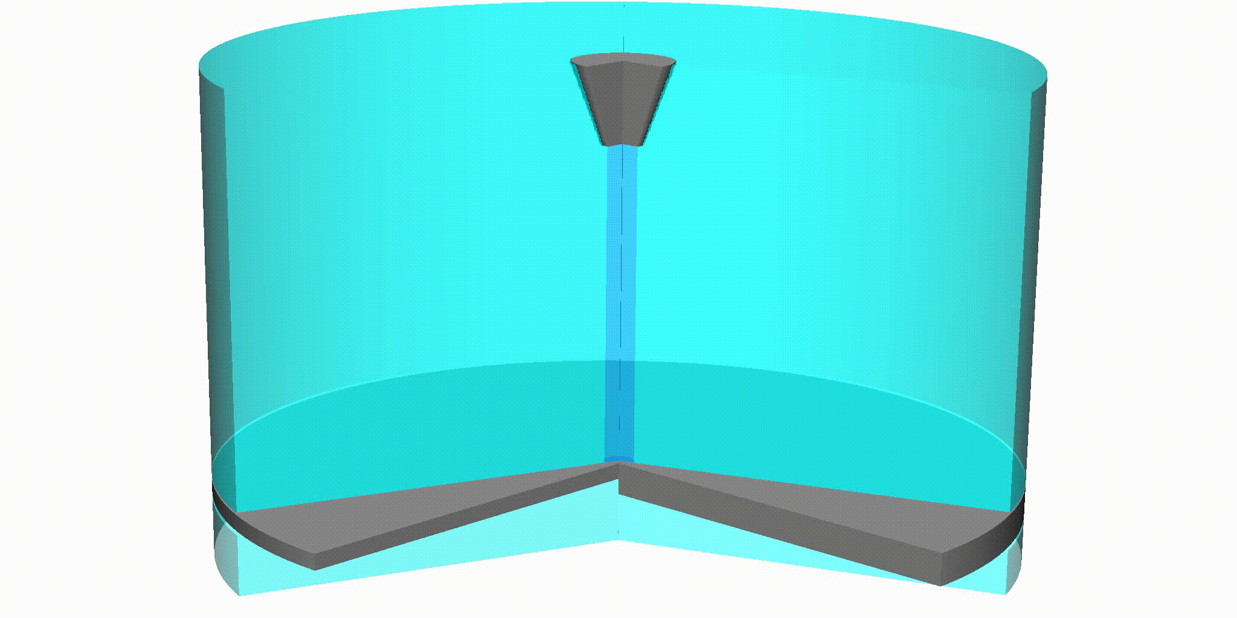
Level set methods
They can be used to model:
Multiphysics (of course)

Slide 20
Outline
Implicit boundary methods
Numerical methods for level sets
Defining level set functions
Reinitialisation

Slide 21
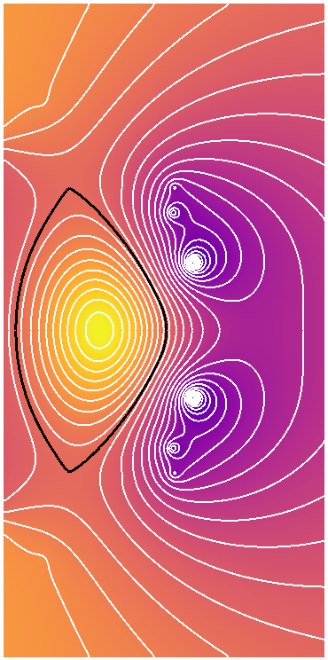
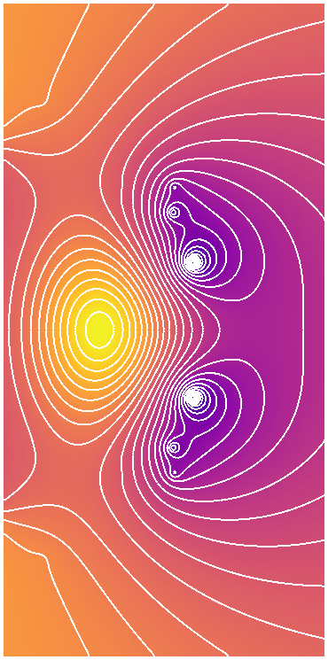
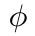
Level sets for modelling interfaces
Level set methods are our method of choice for modelling sharp interfaces
In many ways, level set is just a mathematical name for contour
The level set is the set of points which all take the same value (i.e. are level)
This is then referred to as the level set function, typically labelled
It is often convenient to use the zero-contour of a function as the level set function, but not strictly necessary

Slide 22
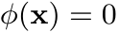
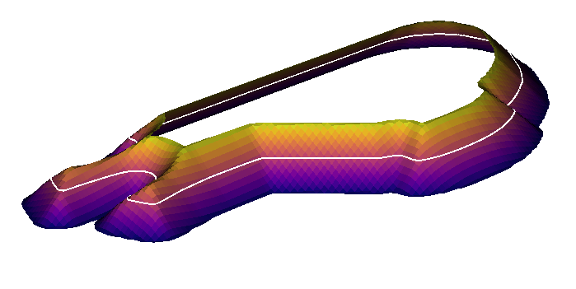
Level sets for modelling interfaces
Describing an interface is 'simply' a matter of choosing the correct function, , for which
However, this is not all there is to a level set method - many of the examples shown require that the interface moves
Therefore some form of evolution equation is needed for , and this must be formulated such that it describes the physics of the interface
This does then depend on what you are using your level set method for

Slide 23
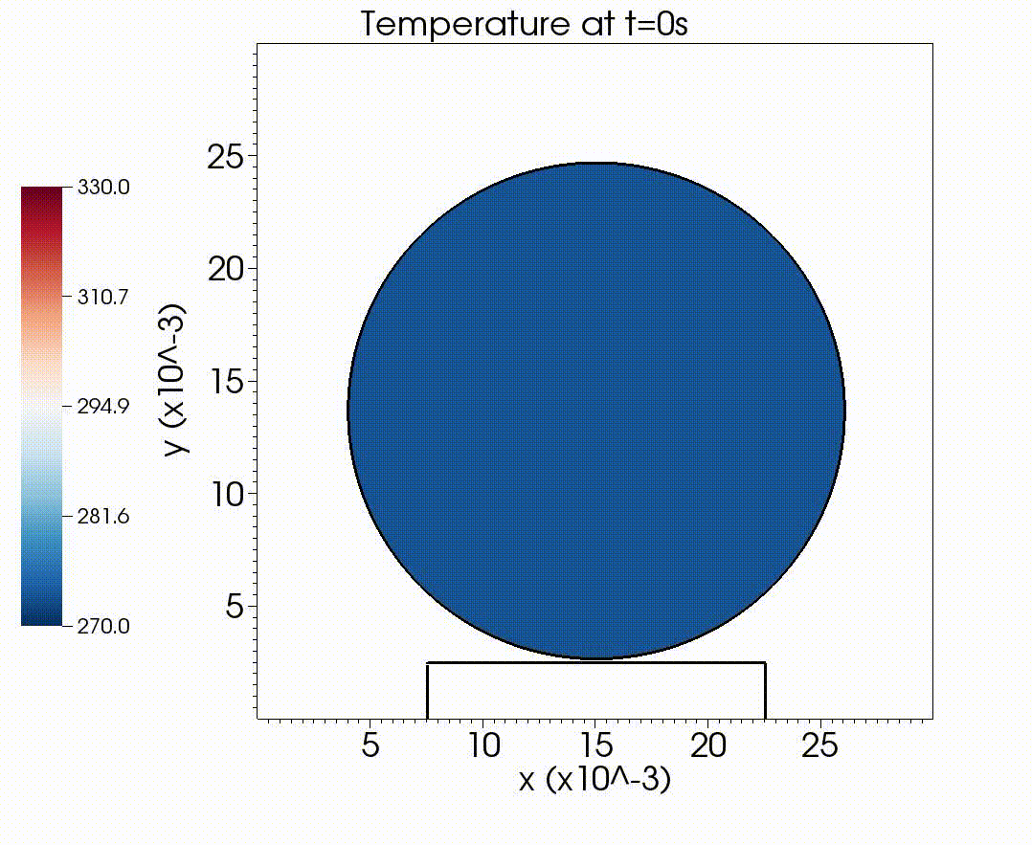
The level set equation
Level set equation is a general term for the evolution equation that is being solved for a given level set function
This must incorporate the physics of the system being modelled
Commonly encountered level set equations are:
Advection:

Slide 24
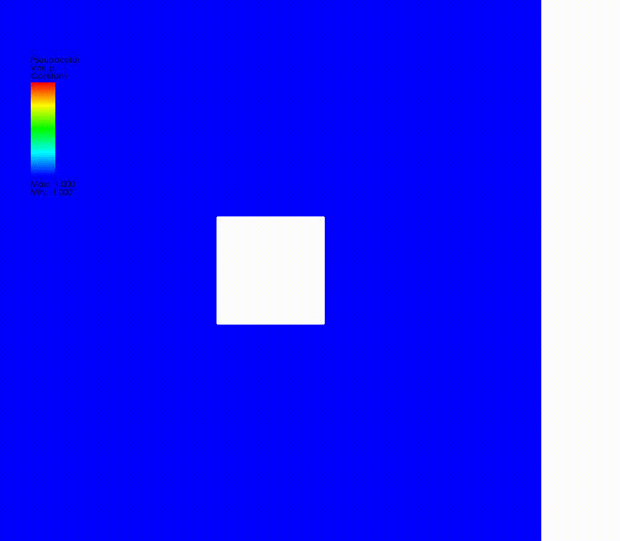
The level set equation
Level set equation is a general term for the evolution equation that is being solved for a given level set function
This must incorporate the physics of the system being modelled
Commonly encountered level set equations are:
Normal motion:

Slide 25
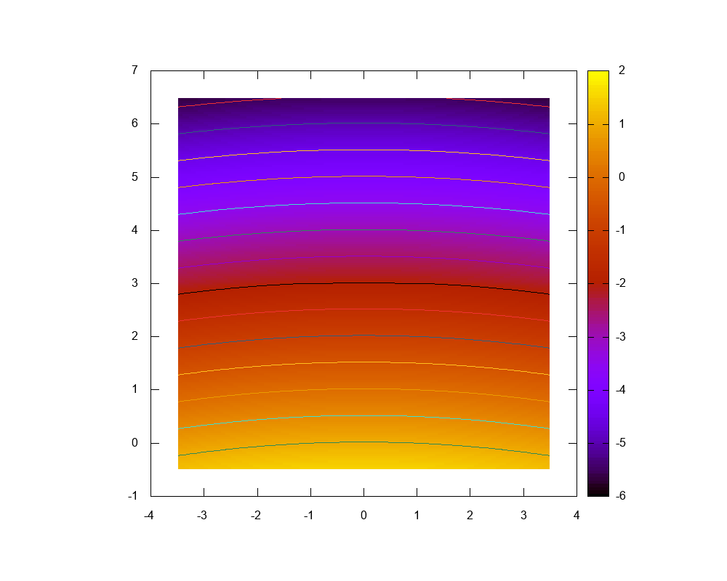
The level set equation
Level set equation is a general term for the evolution equation that is being solved for a given level set function
This must incorporate the physics of the system being modelled
Commonly encountered level set equations are:
Curvature-driven motion:

Slide 26
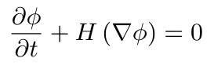
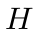
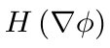
Hamilton-Jacobi equations
Many level set equations are a type of Hamilton-Jacobi equation
These equations have the form
Here, the operator, , acts upon the gradient (first derivatives) of the level set function
Note: Hamilton-Jacobi equations are not conservation laws
Second derivatives – Not a HJ equation

Slide 27
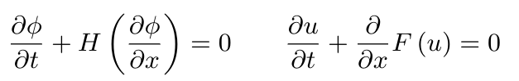
Relationship to conservation laws
We have spent quite a lot of time making sure we solve conservation laws whenever we can
This was due to the fact that discontinuities can easily occur for non-linear equations
For Hamilton-Jacobi equations, we can get away with this non-conservative form because there is a relationship to conservation laws
This can be shown simply (but only in 1D)

Slide 28
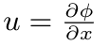
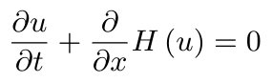
Relationship to conservation laws
To derive the relationship, we take the derivative of the H-J equation with respect to space
We then define the variable
We can then express this as
The spatial derivative of a Hamilton-Jacobi equation obeys a conservation law

Slide 29
Integral solution to a conservation law
We can say that the Hamilton-Jacobi equation is the integral solution to a conservation law
It is perfectly possible for the conservation law to have a discontinuity
But, in order for the evolved level set function to have a discontinuity, the solution from the conservation law must be a delta function
Whilst possible, when considering physical variables, we do not expect such behaviour to occur
As a result, we can solve the Hamilton-Jacobi equation directly

Slide 30
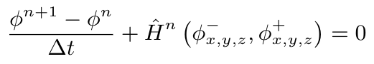
Numerical methods for Hamilton-Jacobi equations
Unfortunately, considering a new class of methods does require a few tweaks to numerical methods (at least, for more than first order accuracy)
We do at least have a scalar equation
A discretised Hamilton-Jacobi equation will often be written like
Time derivative
A discrete representation of the function
An upwind and a downwind derivative approximation

Slide 31
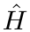
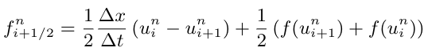
Discrete representation
The discrete representation, , must be carefully chosen such that the correct solution is obtained
However, the methods which can be used are somewhat familiar
For example, the Lax-Friedrichs scheme:
There are clear similarities (and differences) compared to the standard Lax-Friedrichs flux

Slide 32
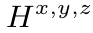
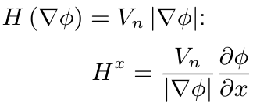
Discrete representation
Because we don't have a conservation law, the maximum information travel time is not as obvious
Instead, we need to introduce some sort of wave speed through , which is based on partial derivatives of with respect to
This is not necessarily easy to compute, or nice to work with
For normal motion, :

Slide 33

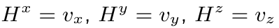
Level set equation for multiphysics
It is clear that numerical methods for Hamilton-Jacobi equations could get complicated
Fortunately, for material interfaces, we know that we are dealing with a feature governed by advection
Here, is the velocity of the physical materials at the interface, and this has no dependence on , which simplifies matters
Firstly, for methods such as Lax-Friedrichs, the information travel speeds are easy to compute (and as expected)

Slide 34
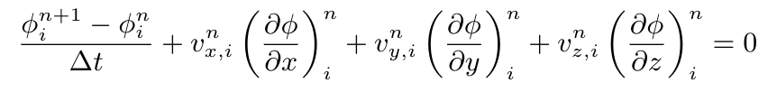
Level set equation for multiphysics
Secondly, the general case of Hamilton-Jacobi equations assumes the velocity is a function of the derivatives of the level set equation
This is not the case for interface advection; we do not have to use the general centred difference to compute spatial derivatives
Instead we can use more familiar upwind approaches

Slide 35
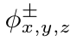
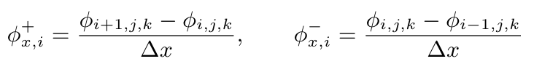
Numerical methods for Hamilton-Jacobi equations
Numerical methods for Hamilton-Jacobi in this form are now 'simply' a matter of choosing approximations for
Since these are to be chosen based on the upwind direction, we can simply use first order derivatives
This is then very similar to the first numerical scheme we considered, the only difference is that velocity will be different in every cell

Slide 36
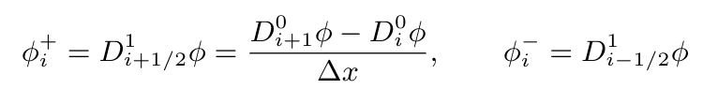
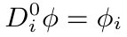
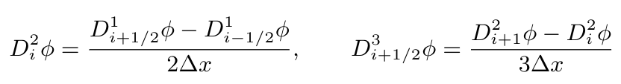
Numerical methods for Hamilton-Jacobi equations
Higher order methods for computing exist, using more cells to compute these terms
To express these, we use the divided-difference notation of Osher and Fedkiw, "Level Set Methods and Dynamic Implicit Surfaces" (2002)
To save space, we consider only the 1D case

Slide 37
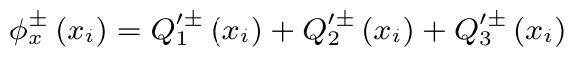
Hamilton-Jacobi ENO method
Although slightly ugly notation, the divided-differences are useful for both fitting equations on slides, but also for coding – they are simple quantities which can be computed in a loop up to any order of accuracy
And because they can be computed to high orders of accuracy easily, it is common to go beyond second order methods for these types of equation
These form a class of ENO (Essentially Non-Oscillatory) method
Here, the derivative terms are given by
Where each term here is simply defined as:

Slide 38
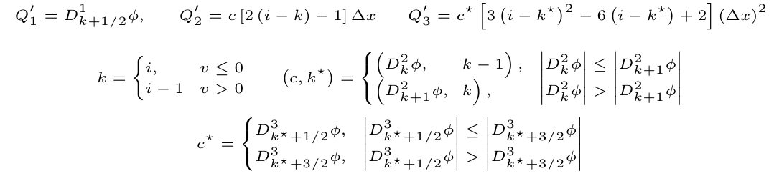
Hamilton-Jacobi ENO method
One of 3 second derivatives
1 or -1
First order derivative
i-2, i-1 or i
2, -1 or 2
This determines whether we use + or -
One of 4 third derivatives

Slide 39
Hamilton-Jacobi ENO method
Not easy reading, but essentially this is just picking the smoothest third-order accurate approximation to from all available stencils
And to code this, it is just a series of logic statements
However, if the solution is smooth over the entire set of third-order stencils, why not combine them to get an even higher order approximation for very little extra effort?

Slide 40
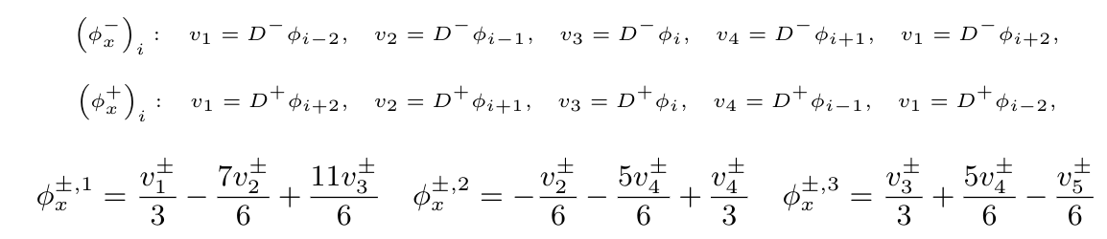
Hamilton-Jacobi WENO method
Combining the possible options for an ENO method gives you a WENO (Weighted Esentially Non-Oscillatory) method
If we work out how the derivative approximations are computed for the ENO scheme, we get one of six possible values
Where, to save space, and are used

Slide 41
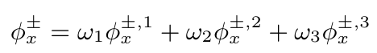
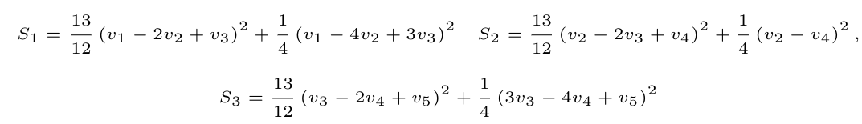
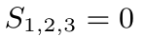
Hamilton-Jacobi WENO method
WENO schemes achieve higher order accuracy by taking a linear combination of the possible derivative approximations,
In order to compute the three weights, three measures of smoothness are used
Since all the terms are first derivative approximations, if these are all identical, we have , the solution is completely smooth

Slide 42
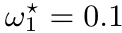
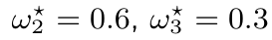
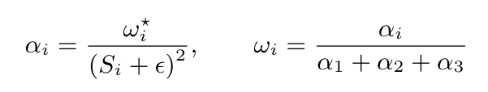
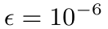
Hamilton-Jacobi WENO method
If we have a perfectly smooth solution, it can be shown that the optimal weights for this problem are ,
The actual weights then use this optimal solution do give weights
So, the bigger the slope, the smaller the contribution from a given weight is
The value ensures that in the case of perfect smoothness ( ), there is no division by zero

Slide 43
Time step with the WENO scheme
This WENO scheme takes a third order ENO scheme, and using all the information available, results in a fifth order scheme
With this level of spatial accuracy, we now worry about time accuracy
And, if we do try using a first order time update, we often see oscillations
It is difficult to say exactly why, since we no longer have any TVD properties
However, in practice, a third-order Runge-Kutta time update (or higher) should be used

Slide 44
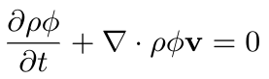
Why do we use non-conservative methods?
For a material interface, it is possible to write the level set equation in conservative form
This could still be used for solving the level set equation
However, because we know that for smooth initial data, discontinuities will not arise for the Hamilton-Jacobi form of the equation, we don't need to use this form
When using level set methods to model an interface, there is (usually) a jump in density at the interface
In this conservative formulation, this means a contact discontinuity (with associated smearing errors) at the only place we need the method to be accurate

Slide 45
Outline
Implicit boundary methods
Numerical methods for level sets
Defining level set functions
Reinitialisation

Slide 46

Why do we like level set methods?
The main reason level set methods are so popular is because they allow for high accuracy at the material interface
This is because they evolve a smooth function, rather than a discontinuous jump
But there are a couple of additional advantages to using a function to describe the interface location
Both the normal direction and curvature of the level set function are easy to compute
Although these are generally computed at cell-centres, because the level set function is smooth, they are accurate enough close to the interface (or can be interpolated)

Slide 47

Signed distance functions
The normal vector (and to some extent the curvature) appear a lot in multiphysics methods, as well as other applications of level set methods
There is one more feature, typically found in level set methods, and that is the signed distance function
In this case, the magnitude of the level set function gives the shortest distance to the interface, where this distance will always be in the normal direction
It can be useful to know how close we are to the interface, including for some multiphysics methods
But also, a signed distance function has , 'halfway' between discontinuous and flat

Slide 48


Example level set functions
When setting up initial data for a level set method, you need some initial signed distance function based on the initial material interfaces
This might be complicated to define for complex shapes, though often simple functions are sufficient
In 1D, signed distance functions are straight lines for single interfaces
Multiple interfaces are also simple, using saw-tooth functions

Slide 49


Example level set functions
Many applications in 2D use a circle, including shock-bubble interactions
The level set function for this is a cone

Slide 50

Example level set functions
Polygons are conceptually simple, but can be a pain to code
You are effectively minimising the distance from each line in the polygon, and to each end of each line
These algorithms can be expensive, but they only need to be done once
And algorithms like this extend to triangulated 3D geometries, e.g. STL files

Slide 51

Maintaining signed distance functions
Constructing signed distance functions can take a bit of effort, but it is a well-understood problem
However, evolution of the level set function does not necessarily maintain this signed distance nature
This is because, although it follows an "advection equation", the velocity of the advection is not constant in space – this can lead to steepening

Slide 52
Outline
Implicit boundary methods
Numerical methods for level sets
Defining level set functions
Reinitialisation

Slide 53
Reinitialisation
Reinitialisation is the process by which a level set can be returned to a signed distance function, whilst maintaining the location of the zero-contour
Otherwise the level set function could become too smeared – easy to introduce errors into the interface location with small changes
Or it could become too steep and resemble a discontinuity – at which point the numerical methods for level set equations would no longer be valid
The idea behind reinitialisation is that as long as we don't change where the interface (zero contour) is, we could define our level set function as anything we want
So if it starts to evolve away from a signed distance function, we can make it a signed distance function again

Slide 54

Reinitialisation example

Slide 55
Reinitialisation
For an implicitly defined interface location, we have a major challenge – we do not know exactly where the interface is
If we attempt to ensure that our level set function has everywhere, then in more than 1D, we cannot achieve this without slightly moving the interface
This movement tends to smear out the features along the interface, and we can lose a lot of information
To maintain the position of the interface, we must ensure that any cell directly adjacent to the interface is not changed, i.e. it is held fixed during the reinitialisation procedure
Although this could lead to local sharpening or steepening, we have found this to be much more accurate than allowing the interface to move

Slide 56
Reinitialisation in 1D (MODIFY ANIMATIONS!)
In 1D, reinitialisation is straightforward
Identify points either side of the interface
For the positive value, replace
with a line of slope 1
For the negative value, replace
with a line of slope -1
All other level set information is unnecessary

Slide 57

Reinitialisation
Conceptually, not a lot changes as we move beyond 1D
We are still solving
We just need a more complex algorithm than drawing a straight line
We still have fixed points adjacent to the interface though (only shown on one side of the interface in 2D)
And the rest of the data is still unnecessary for reinitialisation
Effectively we are solving two steady-state problems with Dirichlet boundary conditions

Slide 58
Eikonal equation
Reinitialisation involves solving, which is part of a class of equations known as Eikonal equations
They also have applications in describing electromagnetic beam attenuation and image reconstruction
The Eikonal equation is an example of a steady-state hyperbolic equation, for level set equations, information propagates out from the boundary with speed 1
Using naive numerical techniques would require every solution to evolve the propagation of the information from the boundary across the computational domain
This would be an expensive iterative procedure, there could be the same number of steps as there are cells in the domain
Because we may need to reinitialise frequently, we may need something better

Slide 59


Iterative reinitialisation
Although it is not efficient, iterative reinitialisation is fairly straightforward, and can be made to work with the algorithms we have already implemented
The idea is to consider the solution process to the Eikonal equation as evolving a solution to a steady state
We introduce a fictitious time variable, , to construct a PDE
Provided that the slopes of are always calculated in the upwind direction (closer to the interface) then this equation will evolve to steady state
At steady state, we have , hence we are satisfying the Eikonal equation

Slide 60



Iterative reinitialisation
Choosing the upwind direction for the derivatives is fairly straightforward
Firstly, we can use first order derivatives, since we are aiming for a linear solution
Secondly, the sign of the derivative tells us which direction upwind actually is
For example, if then we should use, otherwise we use
This assumes that the derivative has the same sign in both directions; see Fedkiw et al. for limiting cases

Slide 61
Why use iterative reinitialisation?
Full iterative reinitialisation is expensive; however it can still be used operationally for multiphysics
Recall, we don't actually care about what the level set function looks like everywhere, all we need is to make sure it continues to look good (obey the Eikonal equation) close to the interface
This will ensure the evolution of the level set function is accurate close to the interface
If it is innacurate elsewhere, then we don't mind, future reinitialisation would take care of this if it gets close to the interface (providing no new interfaces are created...)
Because the information is propagated outwards from the interface, then we achieve this relatively quickly – Fedkiw et al. say about 10 iterations is sufficient

Slide 62

Iterative reinitialisation example

Slide 63
Efficient reinitialisation
Fortunately, there are plenty of more efficient reinitialisation algorithms around, and some are also not too complicated
The idea is that each iteration sets one more cell to be a signed distance function
So rather than updating the entire domain to achieve this, why not reinitialise this single cell
The challenge is how do we identify this 'next cell' in more than 1D
Two methods we consider which are inspired by this logic are the fast sweeping and fast marching methods

Slide 64

Fast marching method
The principle behind the fast marching method is that there is a correct order in which we consider the cells when reinitialising
If we start at the closest cell to the interface, and use this to compute reinitialised values for all possible neighbours (those not also adjacent to the interface, or in the wrong material)
Once this has happened, this cell can no longer contribute anything to the solution, we can mark it as fixed
We then chose the next-smallest cell, and carry on
Quite a complex algorithm; every time we compute a new value, we have to work out where it sits in the list of smallest-to-largest cells (it will not necessarily be the largest value)
Can use multimaps in C++, and is an order scheme

Slide 65
Fast sweeping method
We shall not consider the exact details of the fast marching method; it is complex, care is needed to avoid circular dependencies, and a simple, and more efficient method exists (at least in non-parallel computation)
The fast sweeping method of Zhao (2004) avoids this by considering a series of one-dimensional reinitialisation steps (sweeps of the computational domain)
Sweeps are performed in different directions, along different coordinate axes, e.g. x-direction from 0 to N, then y-direction from 0 to N, then x-direction from N to 0, then y-direction from N to 0
With each sweep, all available information is used to compute the level set function, regardless of whether it is accurate or not, but if it gives a better value, than a guess from a previous sweep, the new value is kept

Slide 66

Fast sweeping method example

Slide 67
Fast sweeping method
In this example, the first thing the fast sweeping method did was 'remove' all values not adjacent to the interface
What we actually did was set them to a sufficiently large (positive or negative) value, e.g. greater than the distance across the domain
This way, if any newly-calculated level set quantity is smaller than the current guess, we know it is a better approximation
Once we have done this, we are ready to begin the actual algorithm

Slide 68



Fast sweeping method – the algorithm
Starting with the first cell in the sweep, check if we are adjacent to an interface
If we aren't, move to the next cell. Repeat until we are adjacent to the interface, and then keep going until we are no longer adjacent to the interface, but the previous cell in the sweep was adjacent
Compute the minimum neighbours of our closest cell, e.g. for positive level set, or negative
Plugging these values into our Eikonal equation gives a quadratic to solve
This is the cell whose value we are computing

Slide 69

Fast sweeping method – the algorithm
We try to compute
If this is smaller in magnitude than the current guess for this cell, we keep it
For positive level set, this is always the positive root, and for negative level set, the negative root
If the solution is ill-defined (negative square root), remove the term largest and try again (until successful)
We now move on to the next cell, and repeat from step 3
If we reach another interface cell, we do not do anything until we have got back to a non-adjacent cell whose previous cell was adjacent

Slide 70

Fast sweeping method – the algorithm
Once we have reached the edge of the domain, move to the next cell at the start of the domain
Once we have attempted to apply the algorithm to every cell in the domain, we have computed the sweep
Now we switch directions, as described previously, and begin the sweep algorithm all over again
The efficiency of the algorithm comes from the fact that each sweep is just a single loop over the domain
This then gives an algorithm of order

Slide 71

Fast sweeping method 2D example
Initially we set all values not adjacent to the interface to a large number

Slide 72

Fast sweeping method 2D example
We now do a single sweep – note that it makes good use of interface cells

Slide 73

Fast sweeping method 2D example
As a result, the second sweep doesn't look very different (in this example)

Slide 74

Fast sweeping method 2D example
By the third sweep, we have nearly all the information now

Slide 75

And the final sweep again doesn't do a lot

Slide 76
What method should we use?
In 1D, none of these – just trivially reconstruct straight lines
Otherwise, the fast sweeping method is generally the best choice, due to efficiency, but the simplicity of the iterative method might be advantageous when testing methods
Although fast marching methods are , there can be cases where the absolute number which multiplies the error is large
This is especially true in non-multiphysics applications, in such cases, the fast marching method may have advantages
A single sweep in all directions (2xN) is enough for us, and the fast sweeping method is the obvious choice
For parallel and GPU coding, additional techniques are available, including the block fast iterative and block fast sweeping methods

